Slide 1
Logging in ASP.Net Core
Eswari Uma Ganesan

Slide 2
.NET Core supports a logging API that works with a variety of built-in and third-party logging providers
A logging provider displays or stores logs.
Built-in logging providers
Console
Debug
EventSource
EventLog
TraceSource
AzureAppServicesFile
AzureAppServicesBlob
ApplicationInsights

Slide 3
Configuration
public static IWebHostBuilder CreateWebHostBuilder(string[] args) =>
WebHost.CreateDefaultBuilder(args)
.ConfigureLogging((hostingContext, logging) =>
{
logging.AddConfiguration(hostingContext.Configuration.GetSection("Logging"));
logging.AddConsole();
logging.AddDebug();
})
.UseStartup<Startup>();
}
StartUpClass
{
"Logging": {
"LogLevel": {
"Default": "Debug",
"System": "Information",
"Microsoft": "Information"
},
"Console": {
"IncludeScopes": true
}
}
}
Appsettings.

Slide 4
Controller – Log Errors
public class HomeController : Controller
{
private readonly ILogger _logger;
public HomeController(ILogger<HomeController> logger)
{
_logger = logger;
}
public IActionResult Index()
{
_logger.LogTrace("log trace");
_logger.LogDebug("log debug");
_logger.LogInformation("log info");
_logger.LogWarning("log warning");
_logger.LogError("log error");
_logger.LogCritical("log critical");
return View();
}
}
Log Level | Prefix
Critical | crit
Error | fail
Warning | warn
Information | info
Debug | dbug
Trace | trce

Slide 5
Controller – Logging with Scope
public class HomeController : Controller
{
private readonly ILogger _logger;
public HomeController(ILogger<HomeController> logger)
{
_logger = logger;
}
public IActionResult Index()
{
using (_logger.BeginScope("Log Scope Example"))
{
_logger.LogInformation("Begin Scope");
_logger.LogWarning("Test Scope");
}
return View();
}
}

Slide 6
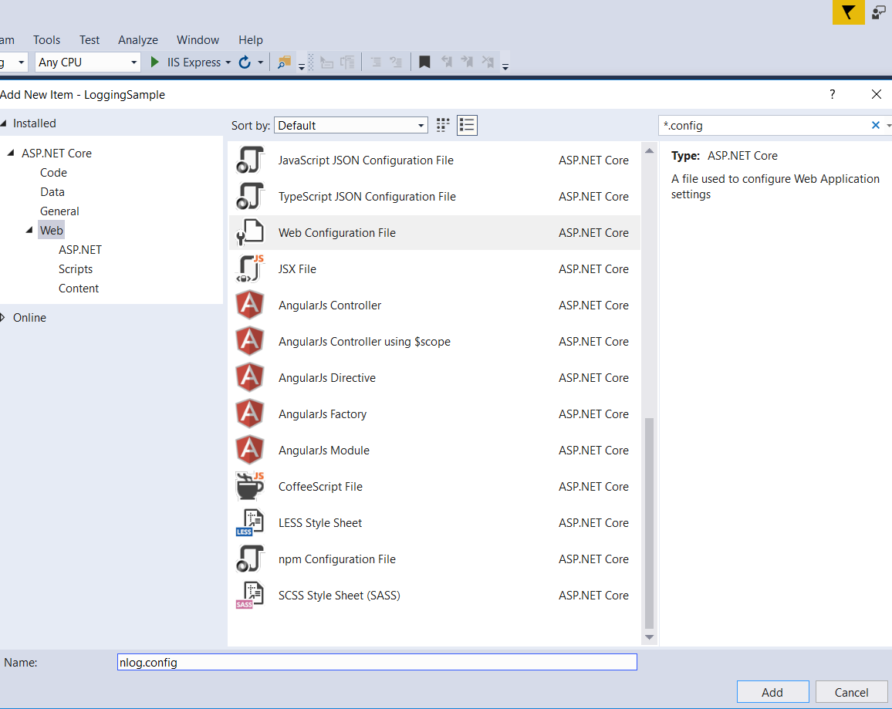
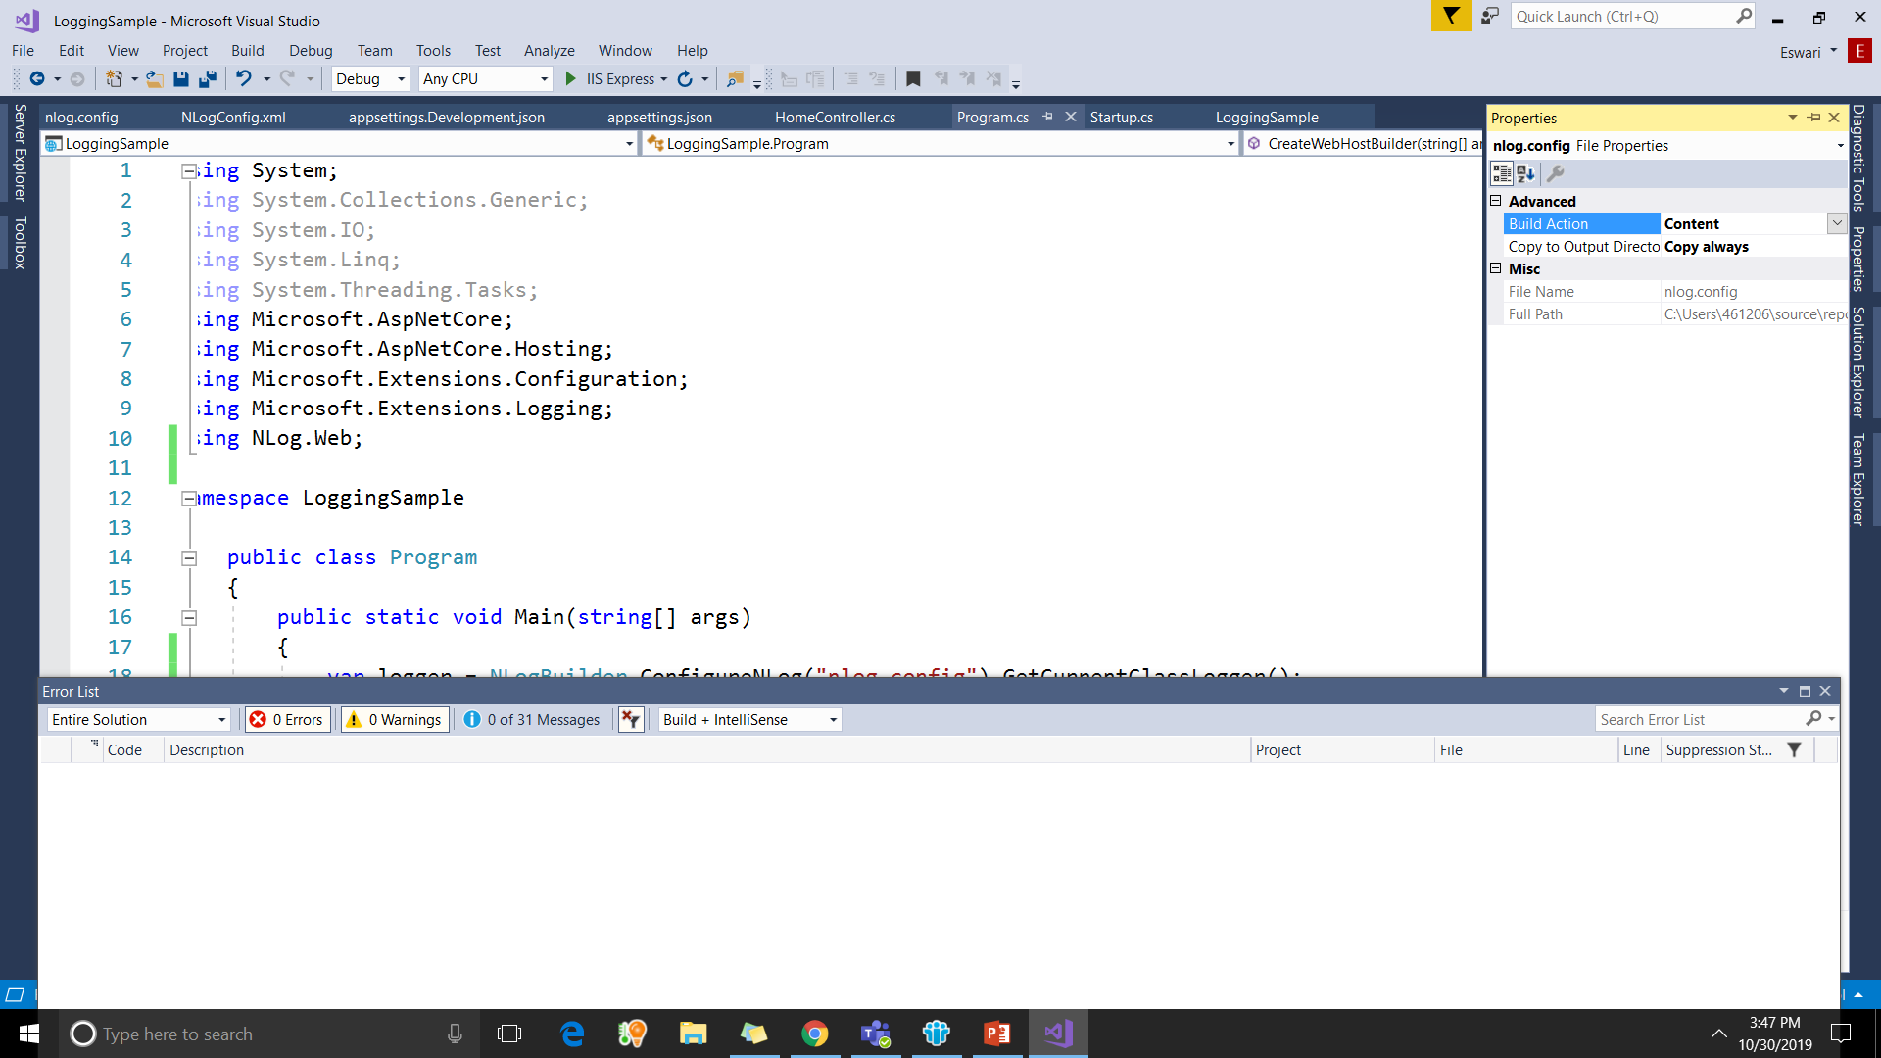
Third Party Logging – Nlog
Logs exceptions to LogFile
Install Nlog Packages using Nuget Package Manager Console
Install-Package Nlog
Install-Package NLog.Web.AspNetCore
Add NlogConfig file

Slide 7
Nlog.Config
<?xml version="1.0" encoding="utf-8" ?>
<nlog xmlns="http://www.nlog-project.org/schemas/NLog.xsd" xmlns:xsi="http://www.w3.org/2001/XMLSchema-instance" autoReload="true" internalLogLevel="info" internalLogFile="internalLog.txt">
<extensions>
<add assembly="NLog.Web.AspNetCore" />
</extensions>
<targets>
<!-- write to file -->
<target xsi:type="File" name="alldata" fileName="LogBasic-${shortdate}.log" layout="${longdate}|${event-properties:item=EventId_Id}|${uppercase:${level}}|${logger}|${message} ${exception:format=tostring}" />
<!-- write to file. Uses some ASP.NET core renderers -->
<target xsi:type="File" name="RequiredInfo" fileName="LogDetails-Specific-${shortdate}.log" layout="${longdate}|${event-properties:item=EventId_Id}|${uppercase:${level}}|${logger}|${message} ${exception:format=tostring}|url: ${aspnet-request-url}|action: ${aspnet-mvc-action}" />
</targets>
<!-- rules to map from logger name to target -->
<rules>
<logger name="*" minlevel="Trace" writeTo="alldata" />
<!--Skip non-critical Microsoft logs and so log only own logs-->
<logger name="Microsoft.*" maxLevel="Info" final="true" />
<logger name="*" minlevel="Trace" writeTo="RequiredInfo" />
</rules>
</nlog>

Slide 8
Program.cs
public static void Main(string[] args)
{
var logger = NLogBuilder.ConfigureNLog("nlog.config").GetCurrentClassLogger();
try
{
logger.Debug("init main function");
CreateWebHostBuilder(args).Build().Run();
}
catch (Exception ex)
{
logger.Error(ex, "Error in init");
}
finally
{
NLog.LogManager.Shutdown();
}
}

Slide 9
Program.cs
public static IWebHostBuilder CreateWebHostBuilder(string[] args) =>
WebHost.CreateDefaultBuilder(args)
.ConfigureLogging((hostingContext, logging) =>
{
logging.AddConfiguration(hostingContext.Configuration.GetSection("Logging"));
logging.AddConsole();
logging.AddDebug();
})
.UseNLog()
.UseStartup<Startup>();
}

Slide 10
Log Errors in DB
https://knightcodes.com/.net/2016/05/25/logging-to-a-database-wth-nlog.html

